Slide 1
Introduction -
Auditory Accessibility
Using X Reality
W3C Workshop
Inclusive design for Immersive Web standards
Wendy A. Dannels
Research Associate Professor
NTID’s Center on Access Technology
November 6, 2019

Slide 2
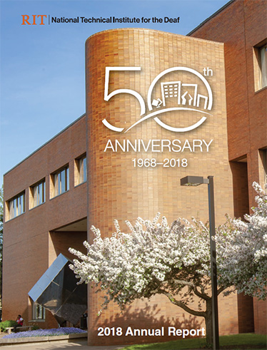
NTID at Glance
National Technical Institute for the Deaf (NTID)
One of the nine colleges of Rochester Institute of Technology (RIT)
World’s first and largest technological college for students who are deaf and hard of hearing
Rochester, New York
DHH students - 1,182 total enrollment
RIT students - 19,042 total enrollment
Student-centered and career-focused

Slide 3
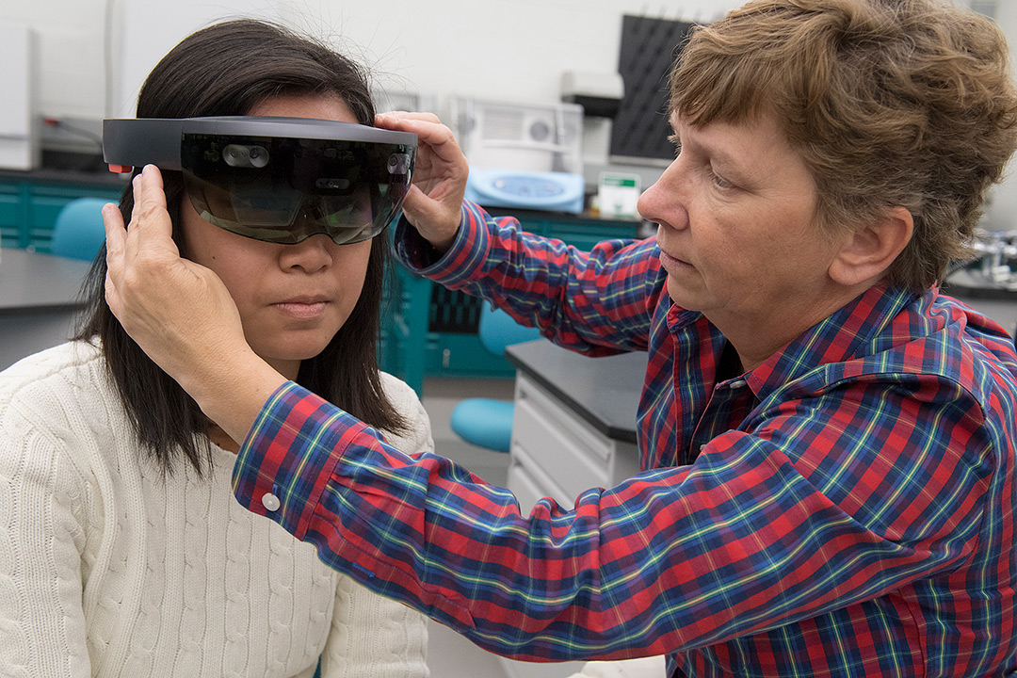
Discussion on X Reality
Based on Auditory

Slide 4
National Association for the Deaf
“It is important that the captions are
(1) synchronized and appear at approximately the same time as the audio is delivered;
(2) equivalent and equal in content to that of the audio, including speaker identification and sound effects; and
(3) accessible and readily available to those who need or want them.
Captions must have sufficient size and contrast to ensure readability, and be timely, accurate, complete, and efficient. When displayed, captions must be in the same line of sight as any corresponding visual information, such as a video, speaker, field of play, activity, or exhibition.”
https://www.nad.org/resources/technology/captioning-for-access/what-is-captioning/

Slide 5
Current Method:
Providing communication and information to access to DHH indivdiduals requires DHH learners to split their attention between the visual focus of the exhibit and the interpreter/captioning display.
At any given point in time, DHH learners are forced to decide what information to miss, with subsequent effects on topic comprehension and perceptions of the inclusivity and accessibility of STEM fields and informal learning environments.

Slide 6

Research Question:
How can the use of X Reality (XR) as a method of support service delivery improve the engagement of adolescent/teen DHH learners in semi-structured learning environments?
Informal Learning
Museums
Science Centers
Zoo
Aquariums
Taken into consideration
Signed and speech explanation
Captioned explanation
Visual materials
Environments
Funded Award #1811509

Slide 7
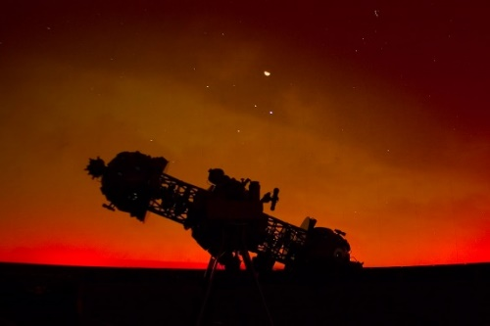
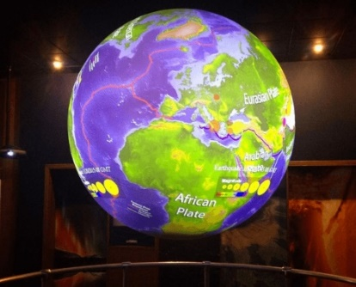
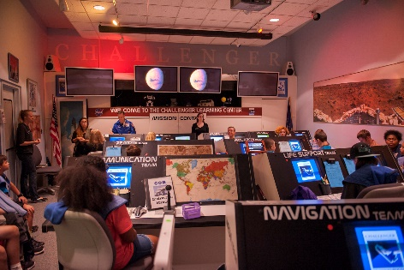
Example:
The project has the potential to transform the experiences of DHH learners in informal settings.
The target audience for this project is DHH learners ages 11-14.
A live program offered at the Strasenburgh Planetarium
A live program offered using Science On a Sphere®
A live and interactive Challenger simulation program involving the spacecraft and a mission control simulator

Slide 8
Innovative Prototype:
DHH visitors will be able to make spontaneous trips to museums instead of needing to arrange interpreting and captioning on-site ahead of time. Instead, remote ASL interpretation and captioning can be called in on the spot to facilitate communication.
DHH visitors can look freely at the museum exhibits surrounding them without missing real-time information from a guide/instructor. They will not need to split their attention between the interactive exhibit and the interpreter/captioning display.
Wireless technologies mean that DHH visitors can move freely about the museum, and ASL interpreters and captioners can remain stationary or even work remotely while providing services to DHH visitors throughout a large exhibit space.
ASL interpreters and educational staff will be able to see exactly what DHH people are viewing through their XR prototypes, resulting in better delivery of service.

Slide 9
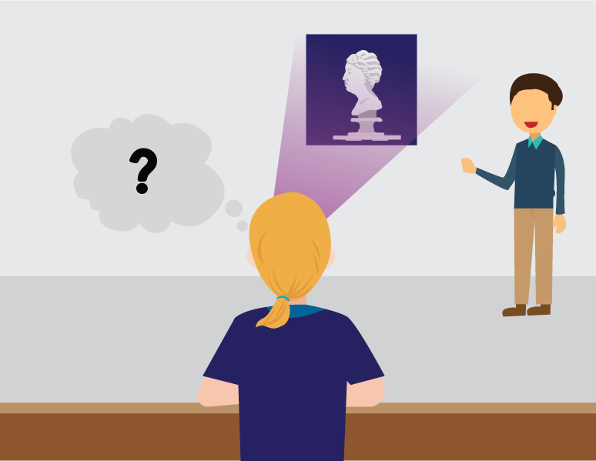
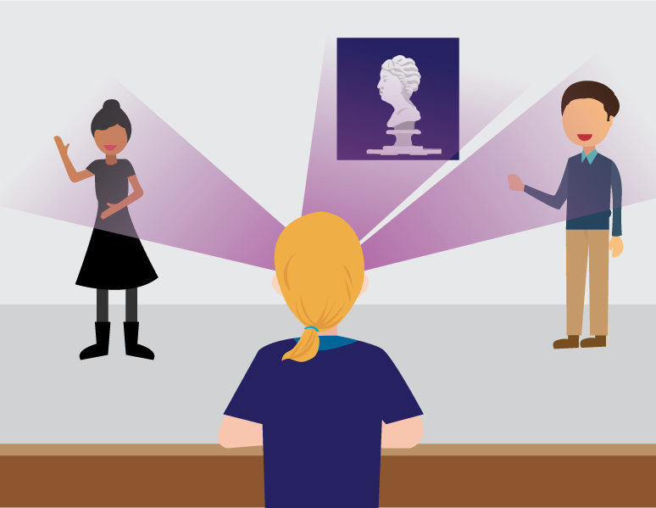
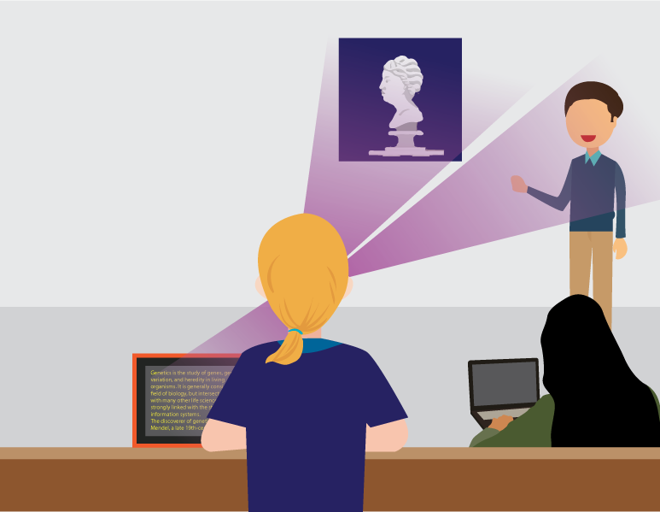
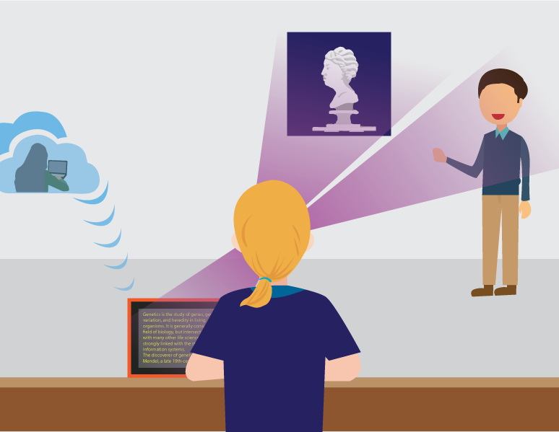
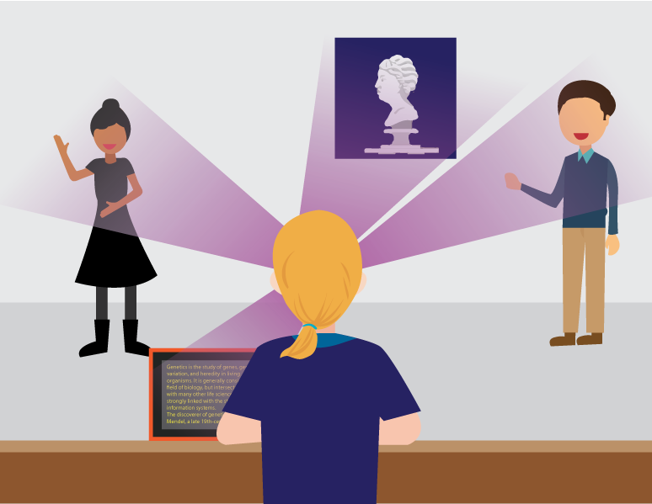
Current Methods:
Fig. 1. Without accommodation
Fig. 2. Live interpreter
Fig. 3. Real time human captionist – onsite
Fig. 4. Other option: Real time human captionist – remote
Fig. 5. live interpreter and
real time human captionist

Slide 10
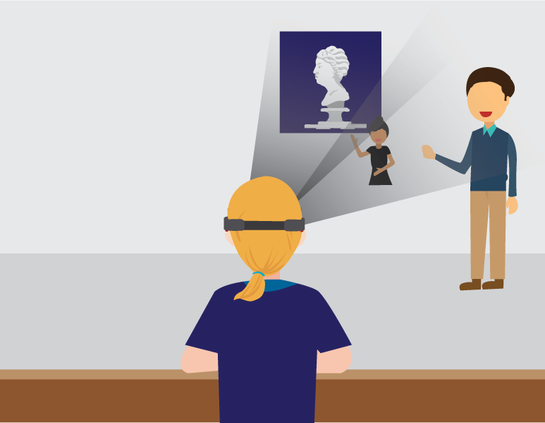
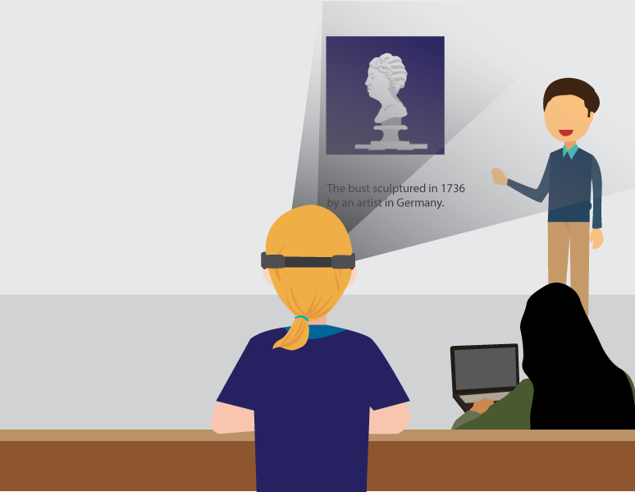
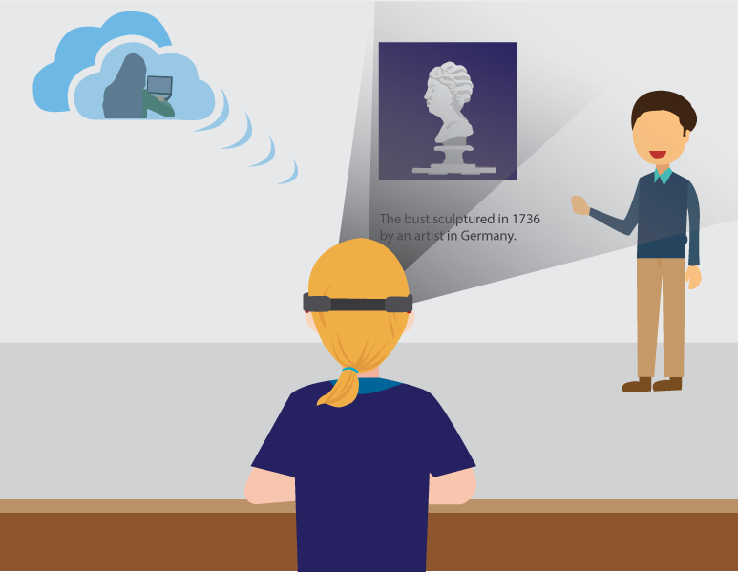
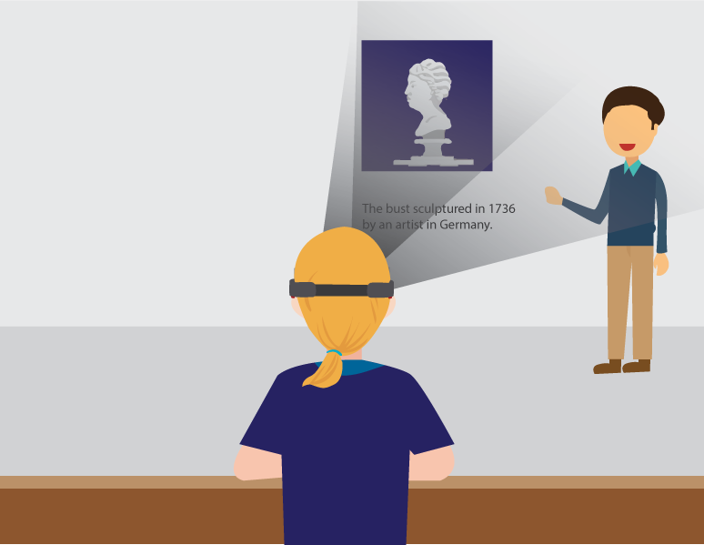
Potential Benefits of using XR Technology:
Fig. 1. Live interpreter
Fig. 2. Real time human captionist - onsite
Fig. 3. Real time human captionist – remote
Fig. 4. Automatic speech recognition captions by artificial intelligence

Slide 11
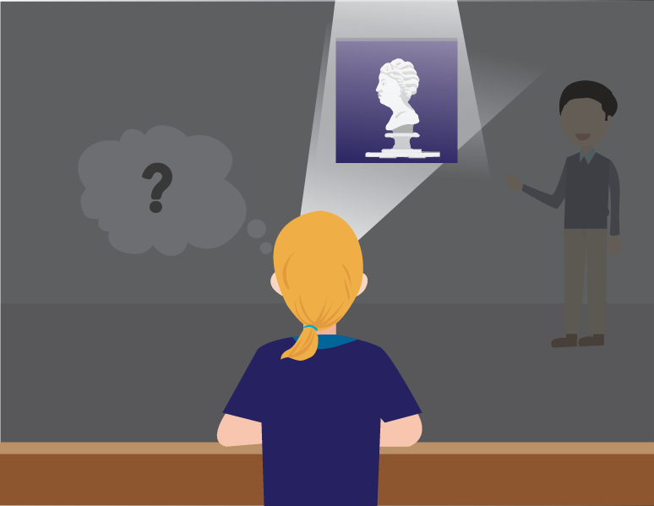
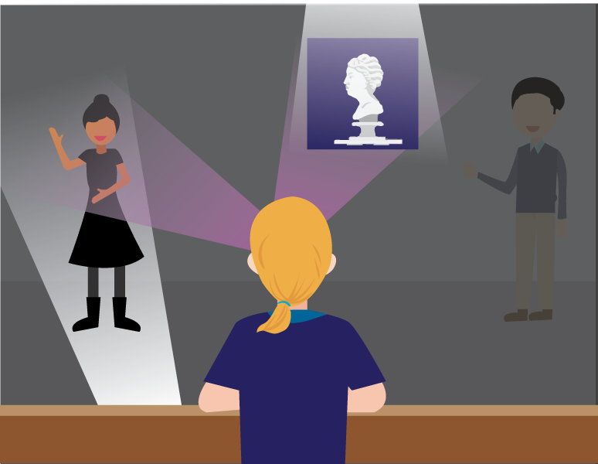
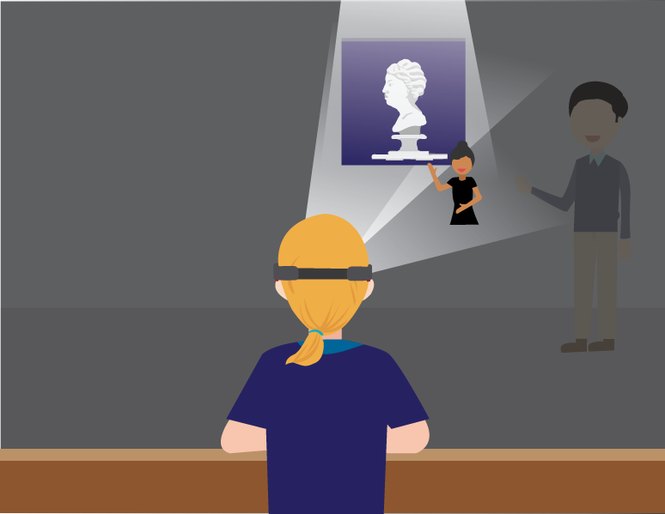
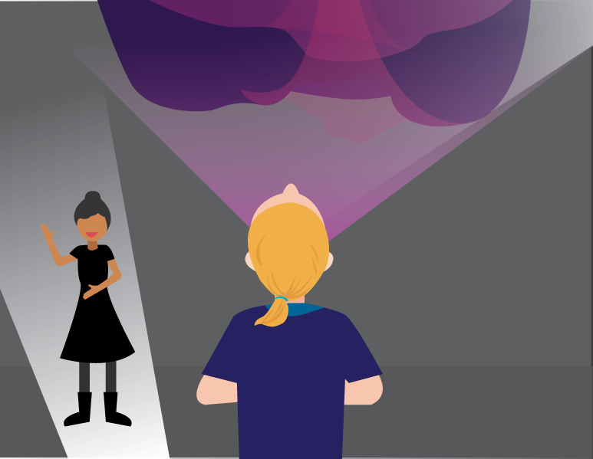
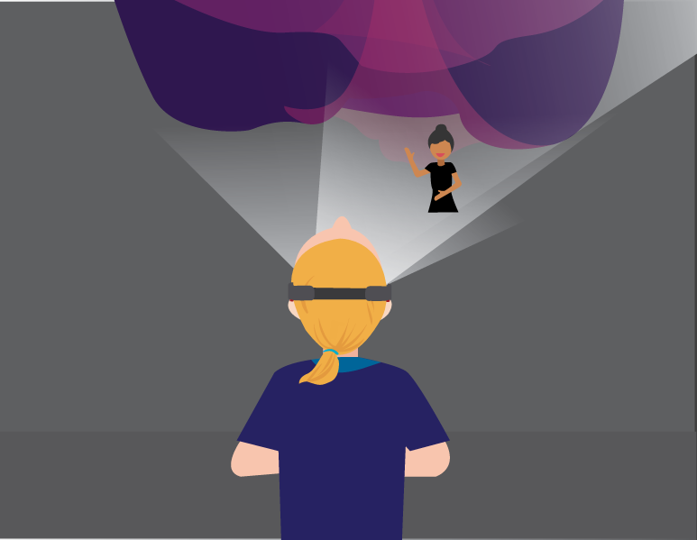
In the dark w/ interpreter:
Fig. 1. Without accommodation
Fig. 2. With interpreter
Fig. 3. Using XR Technology -
With interpreter
Fig. 4. Artwork located far away from the interpreter
Fig. 5. Using XR Technology - Artwork located far away from the floor

Slide 12
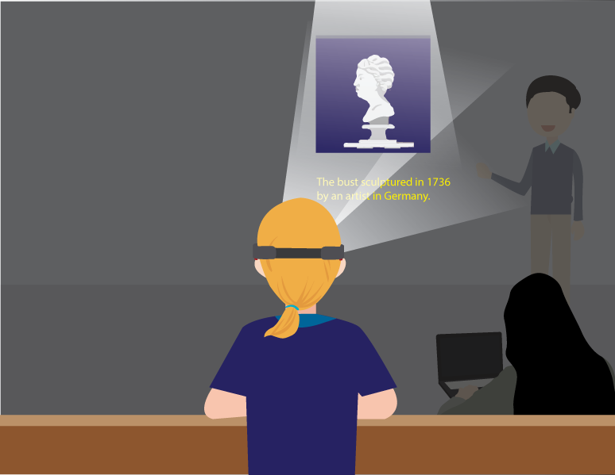
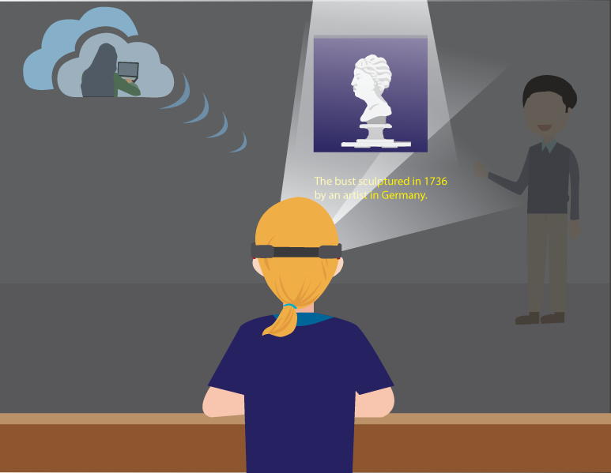
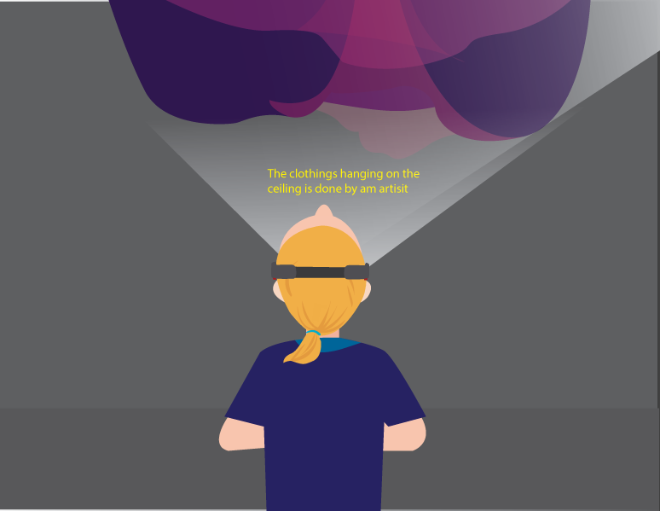
In the dark w/ caption:
Fig. 1. With XR Technology using
real time human captionist - onsite
Fig. 2. With XR Technology using real time human captionist – remote
Fig. 3. With XR Technology using automatic speech recognition captions by artificial intelligence

Slide 13
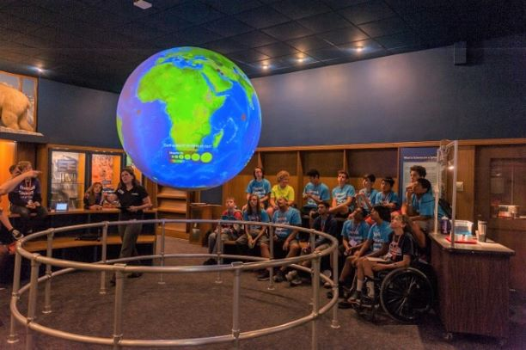
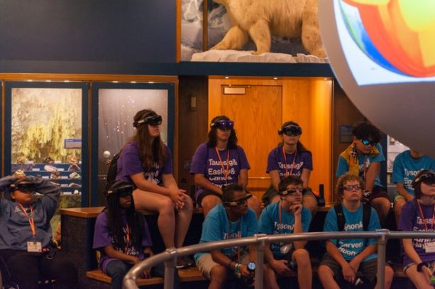

Slide 14
Results:
Vuxiz Blades and M400, HoloLens
WebRTC - latency of less than 200 milliseconds
C-Print
Kiosk version
Solution works over the internet - confidentiality concern
Laptop available for interactive session

Slide 15
Joint Statement on ASR in Captioning Services
Word Federation of the Deaf
International Federation of Hard of Hearing
“When ASR services are used without human operator, deaf and hard of hearing people are excluded from full participation in society.”
1. … has difficulty in providing consistently good recognition accuracy, due to poor sound quality of telephony in certain areas as well as to poor environmental conditions such as noise and an unspecified number of speakers.
2. … some words, such as proper nouns and technical terms that are unknown to the ASR system, are hard to learn beforehand, and it is still difficult to always ensure reliable recognition.”
http://wfdeaf.org/news/resources/27-march-2019-wfd-ifhoh-joint-statement-automatic-speech-recognition-telephone-relay-services-captioning-services/

Slide 16
Challenges:
Real-time captions by human captionists
vs.
Automatic speech recognition captions by artificial intelligence
vs.
Hybrid captions by human captionists and artificial intelligence
AND
How to communicate with others?

Slide 17



